Slide 1
Stock Market Analysis
Stock Market Analysis
Presented By
Mazen Magdy
Abdelrahman Gamal
Ahmed Osama Maher
November 2022

Slide 2
Agenda
Introduction
Data Source
Data Preparation and Cleaning
Data Modeling
BI Queries
Conclusion
Stock Market Analysis

Slide 3
Introduction
Stock analysis is called equity analysis or
market analysis.
Investors or traders make buying or selling
decisions based on stock analysis information.
Stock analysis helps traders to gain an insight into the economy, stock market, or securities.
Stock Market Analysis

Slide 4
Data Source
Wikipedia : List of S&P 500 Companies.
Kaggle :S&P 500 Stock Data.
Kaggle :S&P 500 Historical Data.
Datahub :Constituents Financials.
Kaggle : Daily Gold Price Historical Data
Stock Market Analysis

Slide 5
Data Modeling
Business process
Analyzing and monitoring stock analysis market.
Reporting stock market daily statistics.
Reporting top and lowest performers.
Tracking stock market changes.
Stock Market Analysis

Slide 6
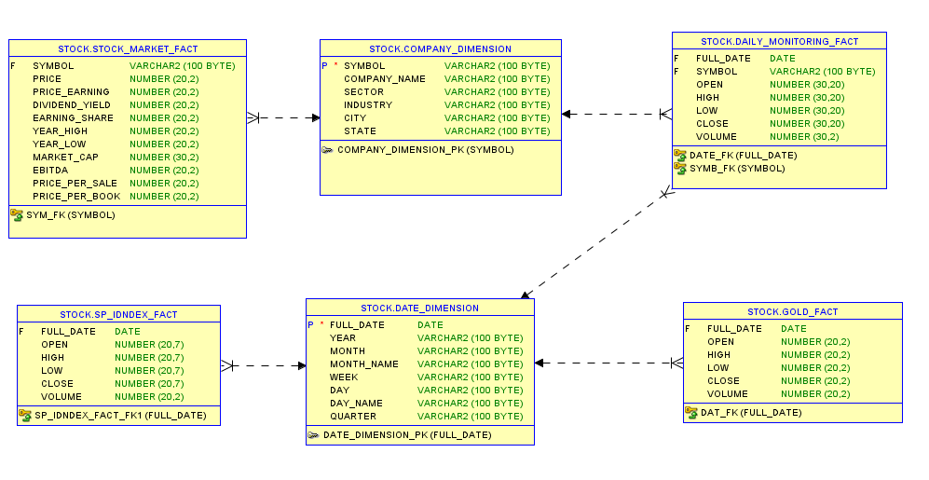
Data Modeling
.
Stock Market Analysis

Slide 7
Data Preparation and Cleaning
Tools Used For Preparation:
Microsoft Excel: It was used in importing data from web and furtherly cleaning and selecting date ranges using power query.
Stock Market Analysis

Slide 8
BI Queries
Q1: What is the top and worst 10 Days Across Stock Market ?
Q2: What is the top and bottom 10 stocks of market cap?
Q3: Is there any relation between SP500 and gold Price?
Q4: S&P to gold correlation.
Q5: Can I take the market cap as the only measure? Is it always accurate?
Stock Market Analysis

Slide 9
Conclusion
S&P To Gold Ratio recommends whether to invest in gold market or S&P500 Stock Market.
Although Market Cap can indicate a lot, It shouldn’t be the only measure to consider!
Amazon and Bank Of America offers a good return on dividend investment But is not recommended in short term investment as price will tend to fall.
Google is recommended for both short and long term investment.
Though Assurant has the least market cap across market, It is highly recommended for short term and offers a decent divided yield for long term investment.
Stock Market Analysis

